Slide 1
Mask Chat
- A web chat application
Shanmugapriya M,
Product developer,
Freshdesk Technology private limited,
Chennai.

Slide 2
Project Overview
To solve women's problem in office/public places.
To bring them a step forward to solve their problems by themselves.
At least to make everyone knows about the problems

Slide 3
Background
Having 2+ yrs experience in this IT field, have faced lots of problem.
was working in a no-use stabled project
mentor hesitated to help me
working in mini project for team which has no use nor learning process
But, I have zero guts to either solve those problems or take it to higher authorities due to family and financial reasons.

Slide 4
Who is your audience?
Working women
Top level management
HR Team

Slide 5
Product Features
Login
HR, CEO and all higher management have separate login with username and password
Anonymous login
Women employee can login directly without giving any identity. A random string is generated for each user
Chat window
A window where problem are discussed without worrying about the identity

Slide 6
Technology Used
Jquery
Node.js
socket.io
express framework
Html
CSS

Slide 7
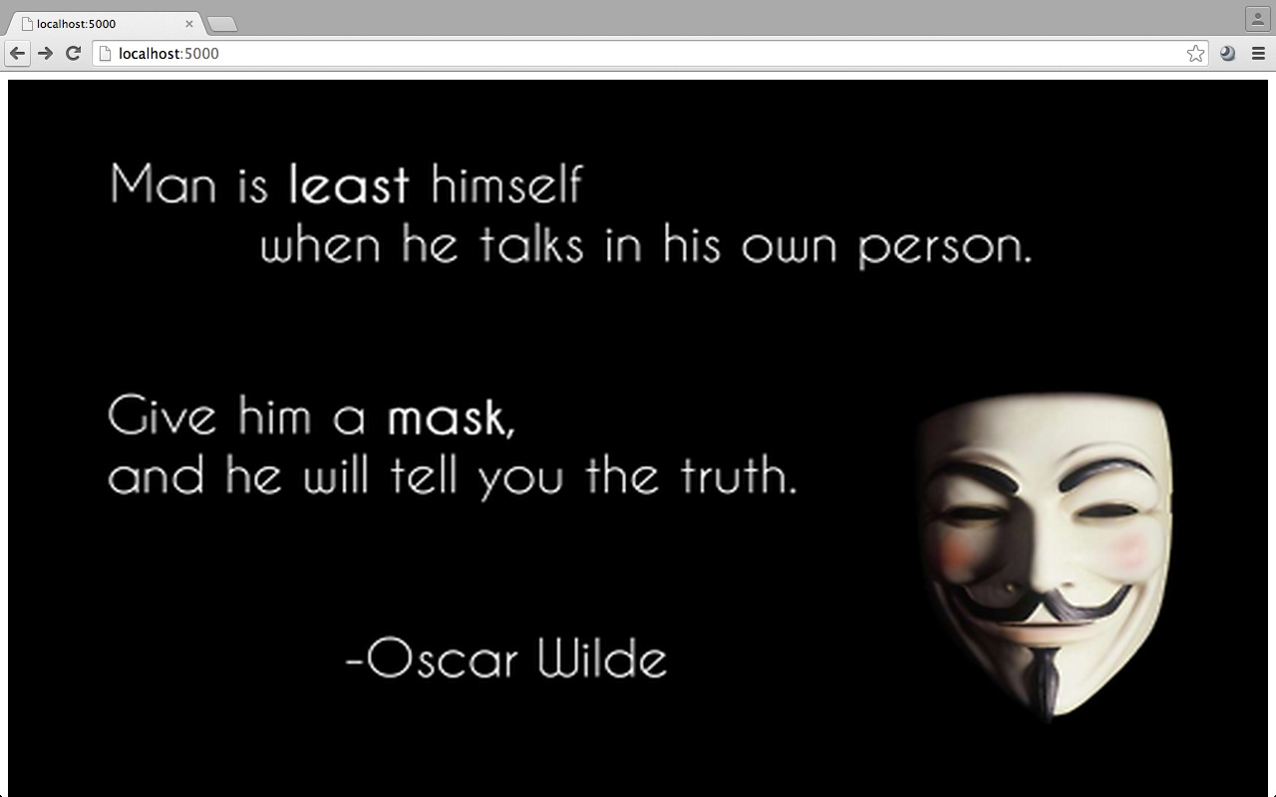
Product Demo

Slide 8
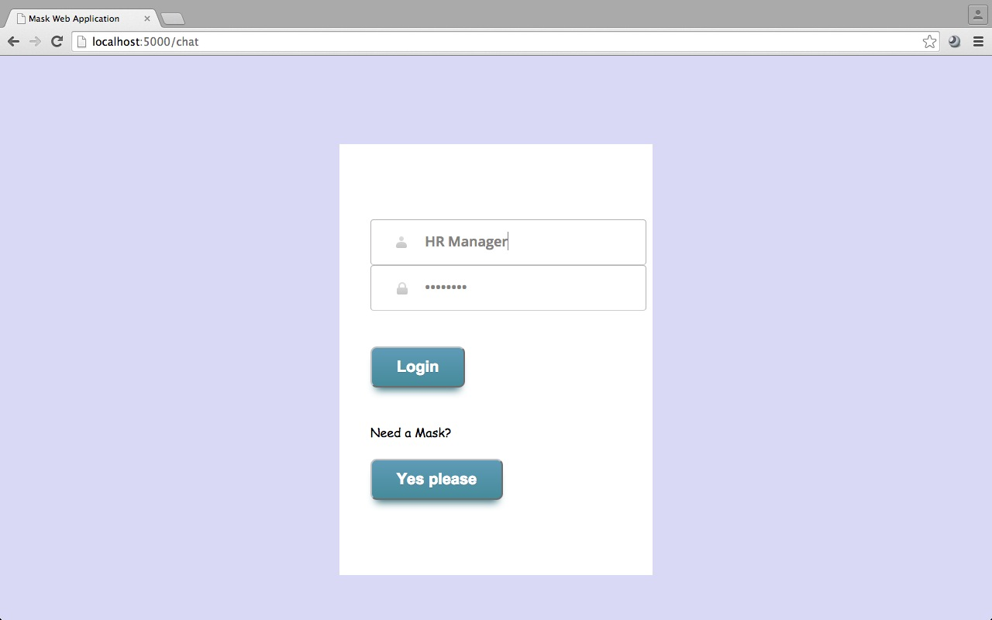
Login Page

Slide 9
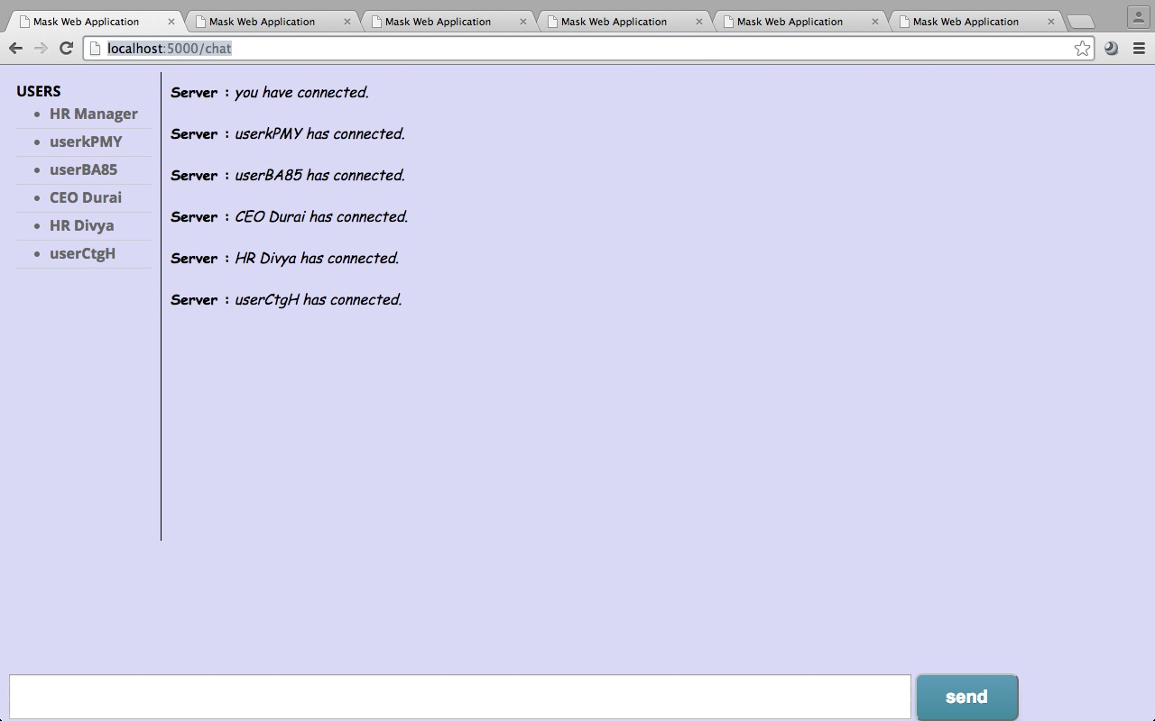
Chat window

Slide 10
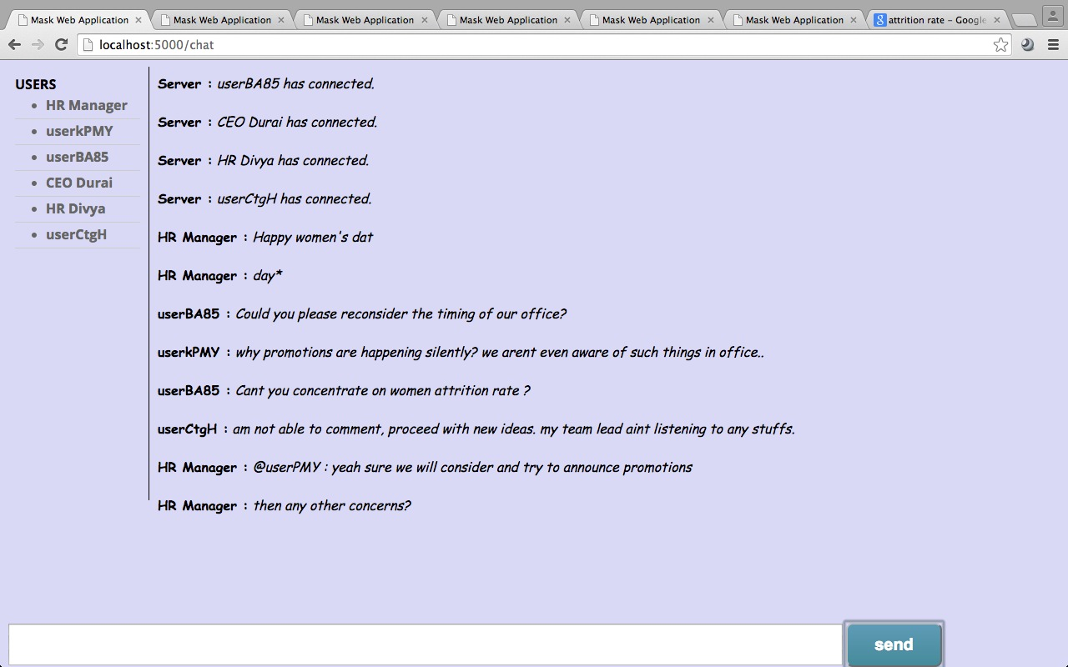

Slide 11
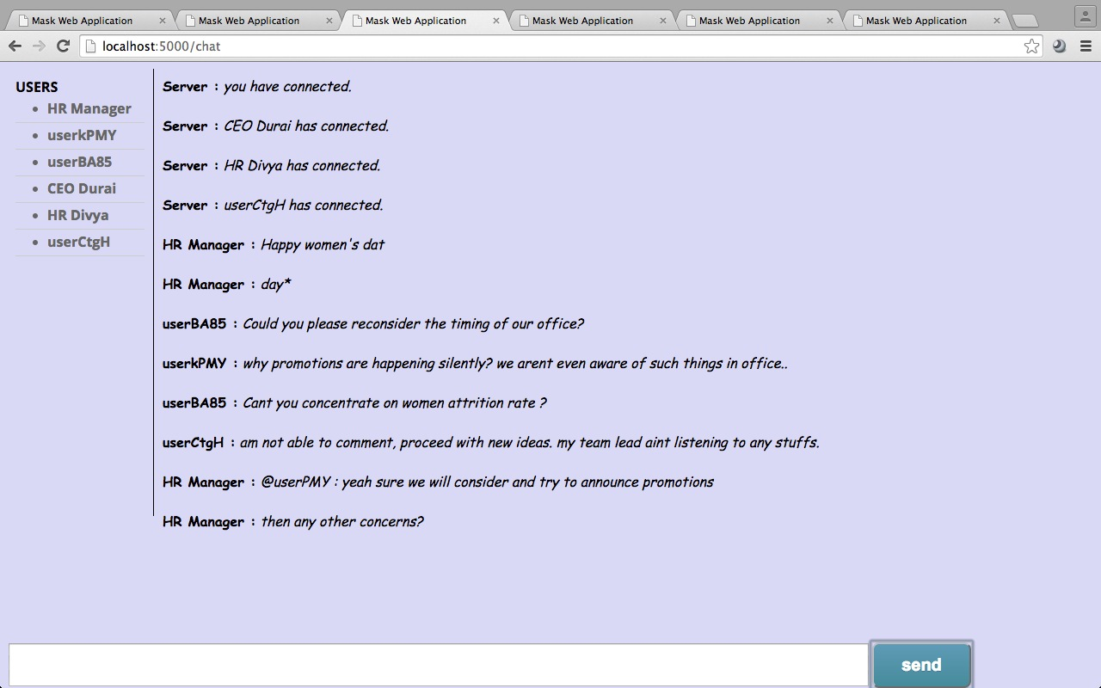

Slide 12
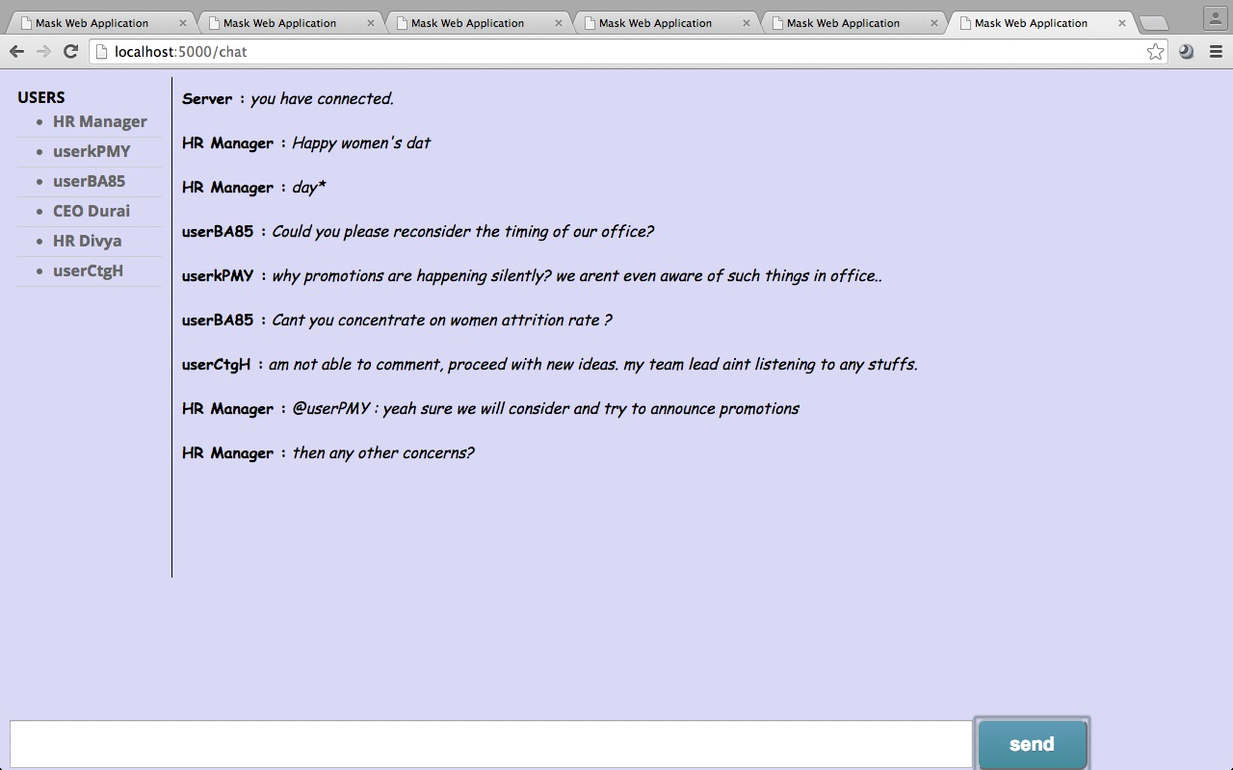

Slide 13
The Process
Created prototype for the chat application
Pending work
Validation
UI
Queuing
database

Slide 14
Additional enhancements
Future enhancements
Moderator
Chat history
option to delete the comment
option to support many languages
speed up the application

Slide 15
Thank you

